Slide 1
Developing Real-Time multiplayer games
Kevin Setiono

Slide 2
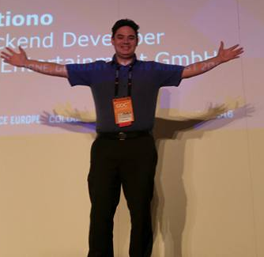
About myself
Freelancer – IT Consulting (Azure and C#)
Work for Hire
Entrepreneur
Starting a Company soon
Projects with AAA Budgets
Often none Game ☹
10 Years professional Experience
~20 Years Hobby Developer
Started with a Tic-Tac-Toe like Game
github.com/KDSBest
kdsbest.com

Slide 3
Code is availble on github
https://github.com/KDSBest/MIGS2017

Slide 4


Agenda
Game Design Effects Interpolation/Extrapolation Capabilities
It‘s all about the money
Latency, Bandwidth & Package Loss
TCP has issues
Network Models
State Synchronization
Deterministic Lockstep
Snapshot Interpolation
Highly Scalable Server Architecture
Simple FPS
Server Architecture in Azure

Slide 5
Game Design Effects interpolation/Extrapolation Capabilities

Slide 6
ExampleLockstepExtrapolation DEMO!

Slide 7
It‘s all about the money

Slide 8
Indies should create network Implementations with care
X = Available O = Hard ? = Possible | UNET HLAPI | Photon (PUN, Thunder, Bolt, etc.) | Own Implementation (ex. Microservices)
Relay | X | X | ?
LAN | X | X | ?
STUN (Punch-Through) | O | X | ?
Replication | Naive | X | ?
Lockstep | ? – (Abuse RPC) | X | ?
Deterministic Physics | ? - (Photons is MIT Lic.) | X | ? - (Photons is MIT Lic.)
Server Code | O | Only Enterprise Cloud | X
Pricing Model | Traffic | Concurrent User (CCU) | Compute (Storage is cheap)
Pricing | 0,49$ / GB | 185$ / 1.000 CCU | 44,64$ - Open End

Slide 9
Let‘s roll the numbers
25 Msgs/sec.
1000 CCUs (constant)
1-on-1 (500 Rooms)
50 byte Packets
UDP Header 8 Byte vs. TCP 20-60 Bytes
Ex. 25 Byte Unit Flag, 1 Byte Click Type, 12 Byte Click Hit, …
25 * 1000 * 50 Byte/sec. = 1.250.000 Byte/sec.
2.592.000 sec. * 1.250.000 Byte/sec. = 3.240.000.000.000 Bytes => ~3 Tbyte / Month
1 Month has 2.592.000 Seconds

Slide 10
How much is it?
 | UNET | Photon | Azure
Monthly | 0$ | 185$ | 230,64$ - 483,60$ (5x A1 v2 - 5x A2 v2)
Traffic | 1470$ (0.49$/GB) | 3TB Included (0.05$ extra GB) | Included
Sum | 1470$ | 185$ | 230,64$ - 483,60$

Slide 11
Show me what you got!

Slide 12
Latency, bandwidth & Package loss

Slide 13
Latency, bandwidth & Package loss
Latency
Time packet needs to deliver to server
~13ms (Test 30-100ms)
Round Trip Time (RTT)
~26ms (Test 60-200ms)
Bandwidth
68.28 Mbps – 41.01 Mbps (Test lower 1Mbps maybe 7Kbps)
Package Loss
0% (Test 5-10% WLAN is an issue)

Slide 14
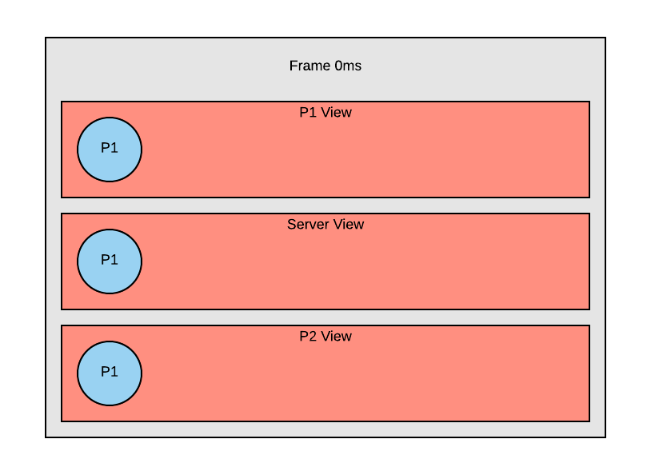
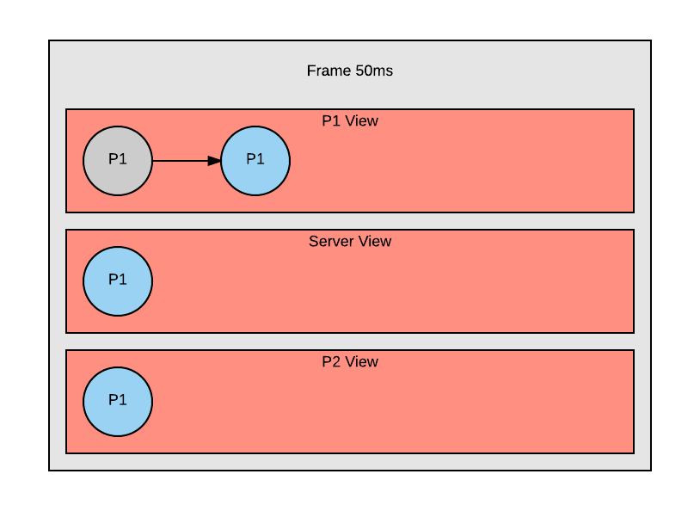
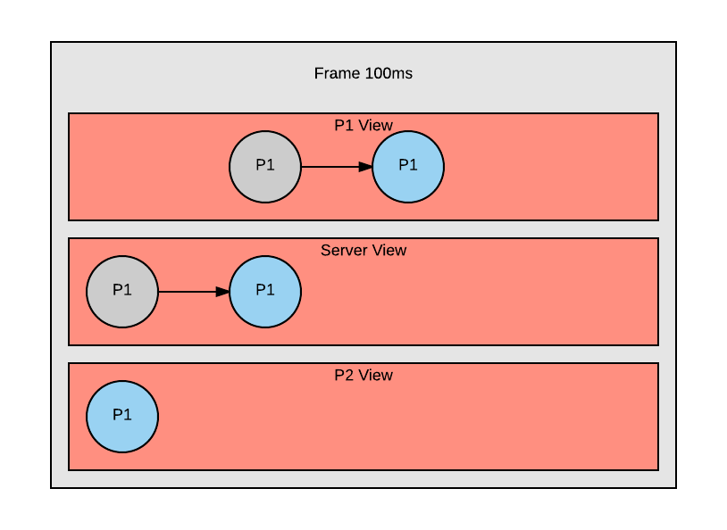
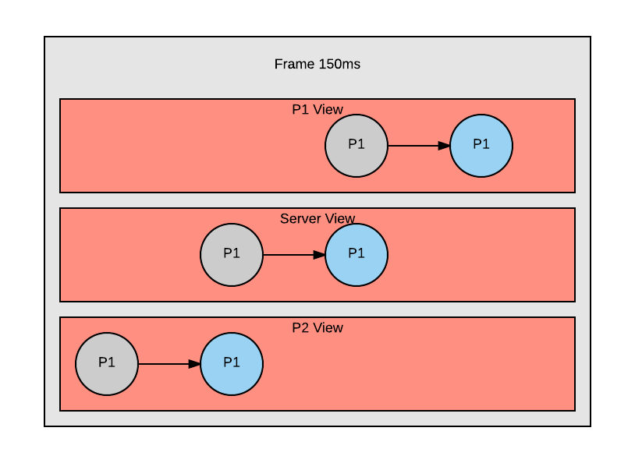
Latency Example
In most cases Player 1, Server and Player 2 Views of the Game World are different!

Slide 15
TCP has issues

Slide 16
Tcp Disadvantages
Packet Loss
2x RTT Wait
Nagle‘s Algorithm (TCP_NODELAY)
Full Packet || All Packets ACK
Overhead
Depending on Bandwith
In Our Example TCP would be up to ~40% more cost!

Slide 17
Network Models

Slide 18
Common network models
State Synchronization
Each object is synchronized with an spezific priority or naive
Used in MMORPGs
Deterministic Lockstep
Deriven Model: GGPO (Beat-em Up)
The Input for the Simulation is synchronized and the simulation is executed on all machine at the same time totally in sync
Used in RTS, MOBA
Snapshot Interpolation
Also known as Quake 3 Network Model (It‘s open source now!)
The Game State is packed in a Snapshot and the clients can interpolte between snapshots
Used in FPS, Racing

Slide 19
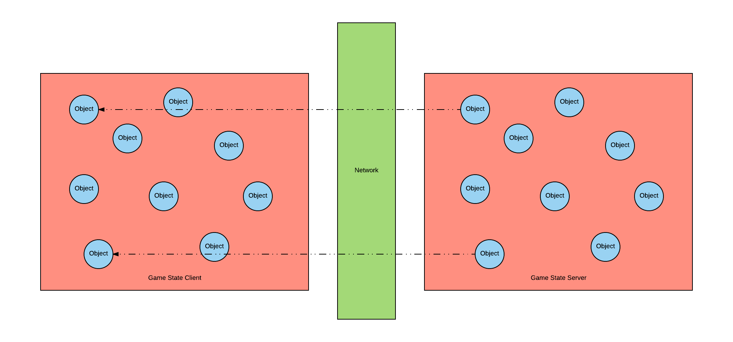
State Synchronization

Slide 20
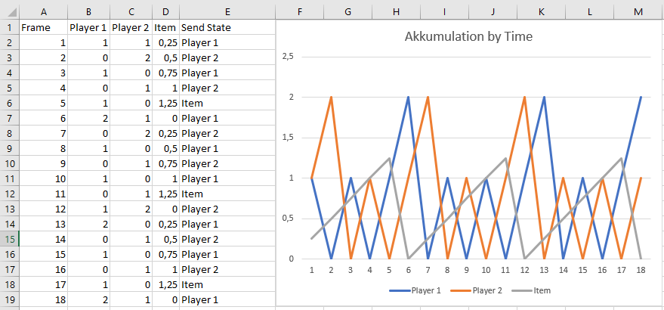
Akkumulated priority
Each Object gets an Akkumulation Value/Formula
If Object is Send via Network the Akkumulation is set to 0
All Objects gets send, but you can priorize how often
Affinity
Distance
Importance
Scale Bandwidth
Easily Add/Remove Objects

Slide 21
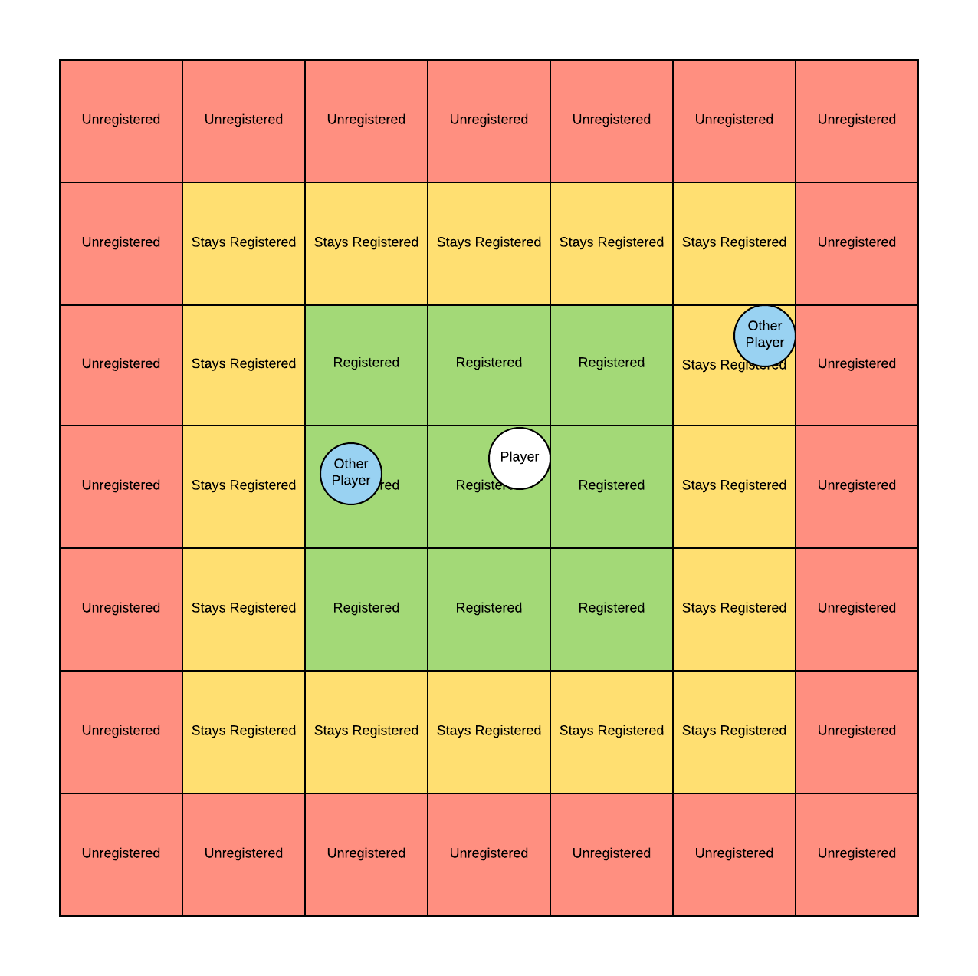
Interest Management
MMORPG Map
Only get Information from Registered Tiles
Stays Registered Tiles doesn’t register/unregister
Prevent constant unregister/register overhead
Unregistered Tiles get Unregistered
Accumulated Priority based on Registration

Slide 22
State sync
Pro | Cons | Cheats
Priority (e.g. Akkumulated Priority) | High Bandwidth | Remove anything from network that shouldn‘t be seen
Player Latency only effects himself | Replay Mechanism | Validate all Input, Speed Hack, etc.
DropIn | Replay Size
Interest Management | Hard to Debug
Scale Bandwidth

Slide 23
State Sync DEMO!

Slide 24
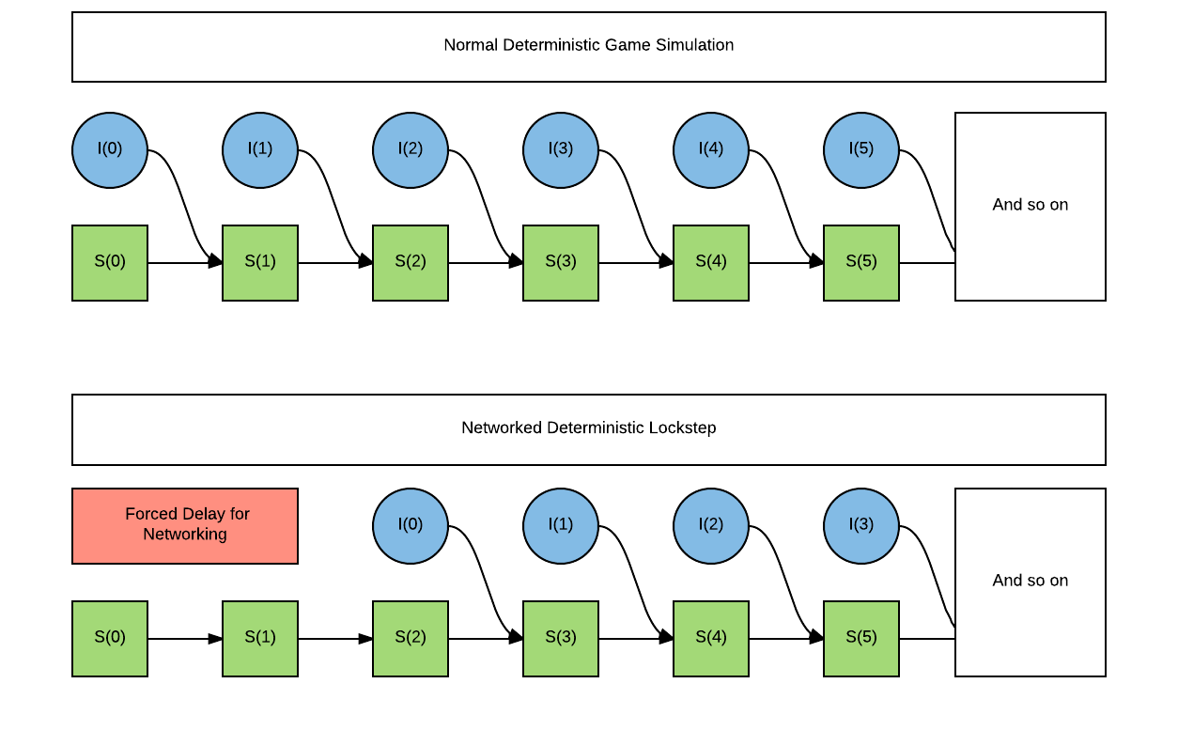
Deterministic Lockstep
Input + State = Next State
Force Delay for Networking is often called Scheduler
Lag creates incomplete Input
All have to wait
Server forces Input on Player (No Operation or Bot)

Slide 25
Determinism
Float Operations are not guarantee to be determinsm
Sin, Cos and so on shouldn‘t be determinsm
+, -, *, / are according to IEEE Standard
It‘s not recoverable to recover out of sync
In Debug provide GameState Snapshots in case of out of sync

Slide 26
Lag and Packet Loss
Packet Loss
Reliable, Ordered Udp
Merge Packets (e.g. I0, I0+I1)
Lag
Server detects and Send NoOp for Lag Player
Assumption but LoL does that
Kick Player and DropIn
Everyone halts and maybe kick Player
SC2
No DropIn
Send Information Redundant till ACK

Slide 27
Deterministic Lockstep
Pro | Cons | Cheats
Low Bandwidth | Deterministic Simulation | Map Hack
Simulation is in Sync | All suffer from high latency player | Look Ahead
Replay mechanism | DropIn | Out of Sync Game Loss (Server is King)
Replay Size
Easy to Debug

Slide 28
Lock Step DEMO!

Slide 29
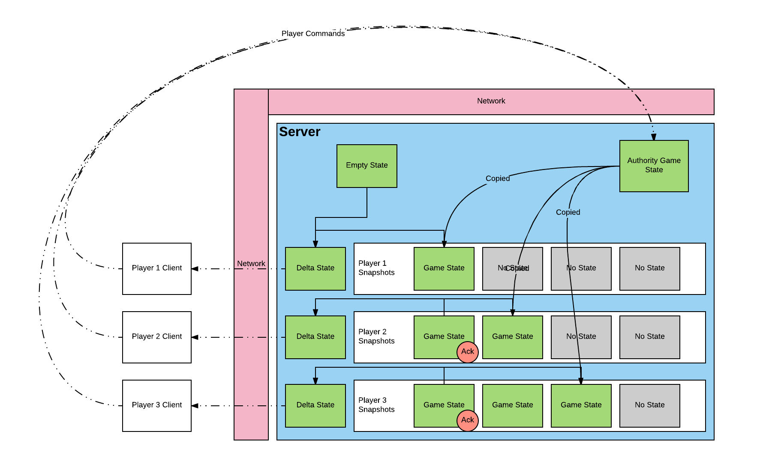
Snapshot Interpolation

Slide 30
Snapshot Interpolation
Pro | Cons | Cheats
Replay Mechanism | High Bandwidth | Remove anything from network that shouldn‘t be seen
Player Latency only effects himself | Game State should fit Snapshot | Validate all Input, Speed Hack, etc.
DropIn | Replay Size | For example invisible players get a Vector3.negativeInfinity Position
Easy to Debug

Slide 31
Highly Scalable Server Architecture

Slide 32
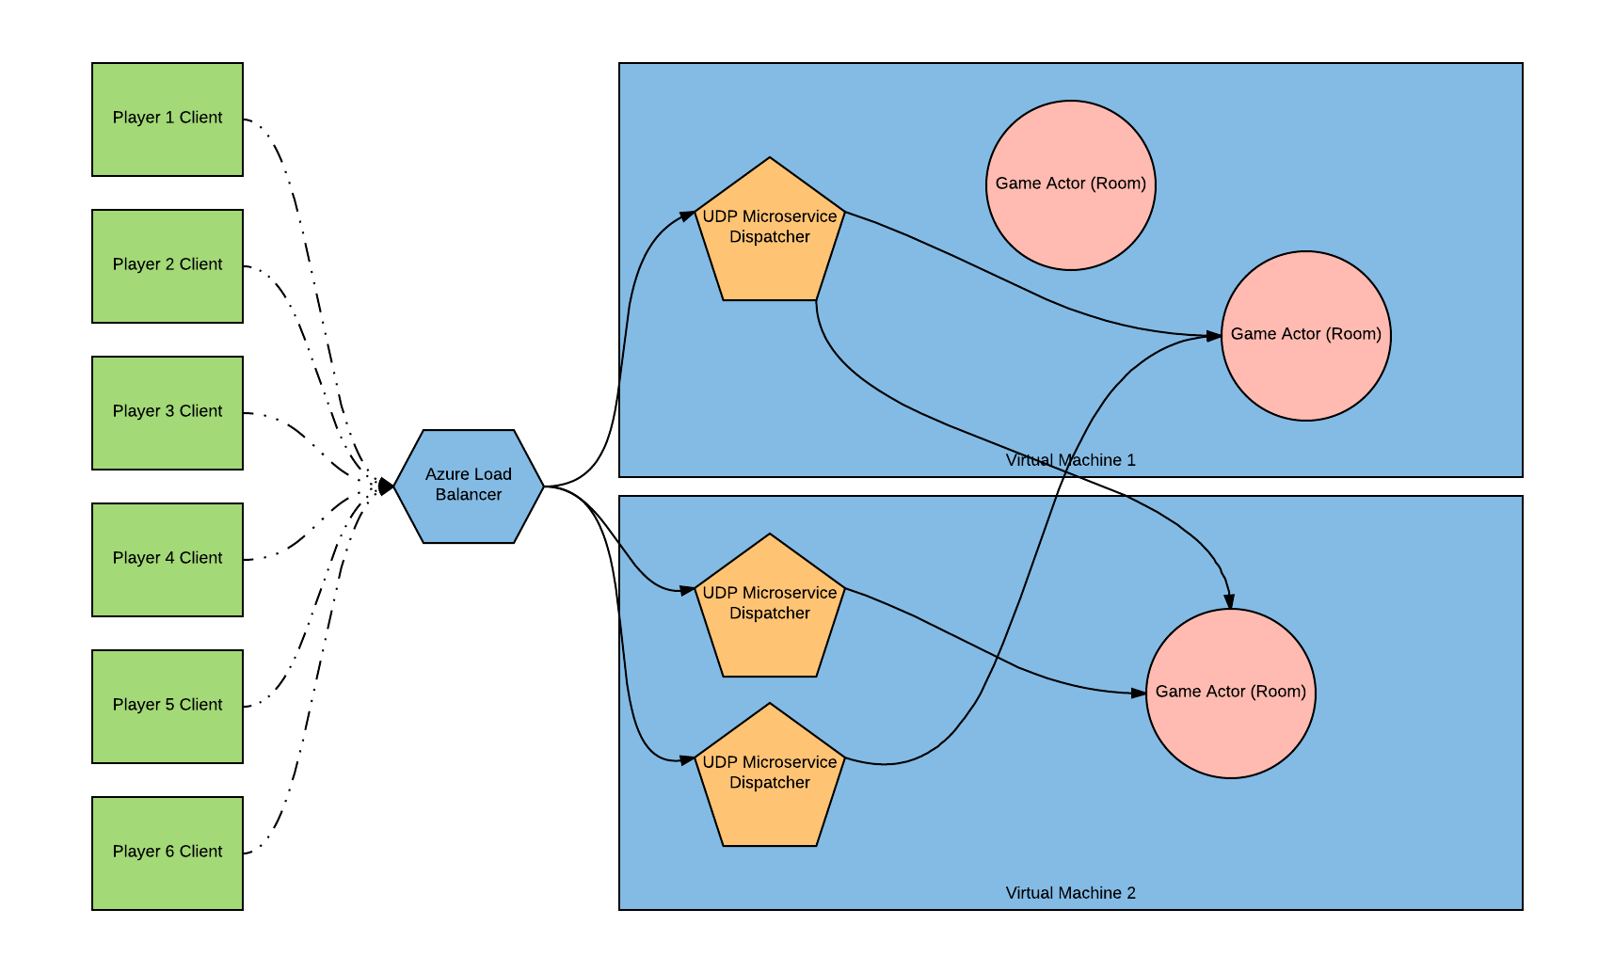
Highly Scalable Server Architecture

Slide 33
simple FPS
Highly Scaleable Server Architecture
Azure Service Fabric
Actor Model
Microservices
Limit Game Mechanics
0-Lag Rail Gun
Walk Around without Collision Detection
Snapshot Interpolation

Slide 34
Simple FPS DEMO!

Slide 35
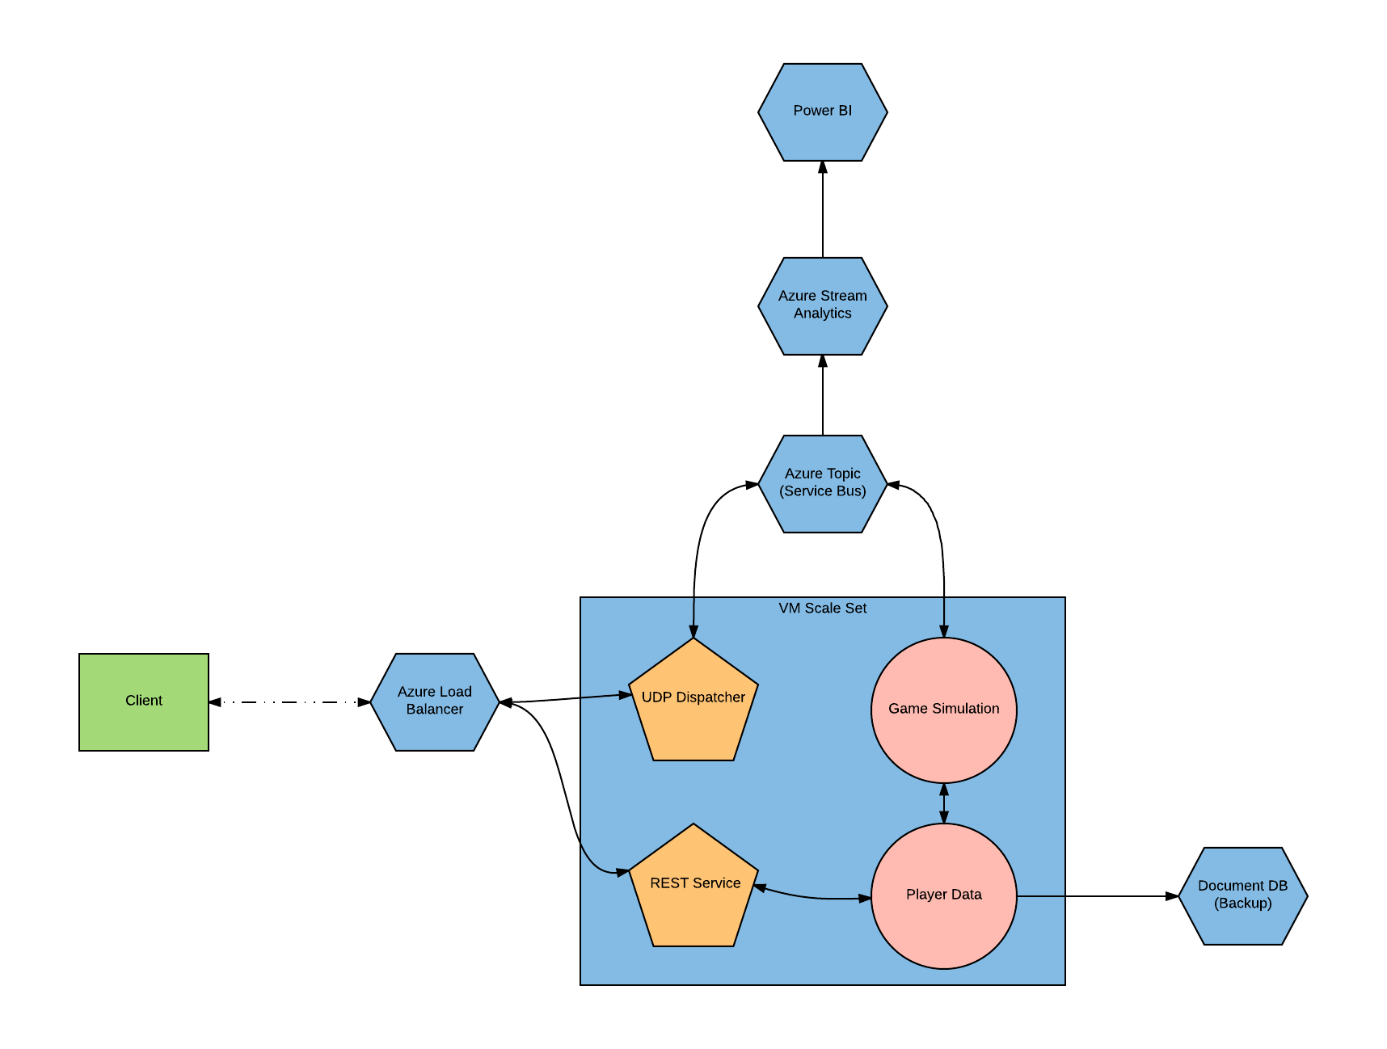
Server architecture in azure
Diagnostics
Stream analytics
Power BI
UDP Dispatcher and Game Simulation
Rest for JWT Token + Login
Document DB as Backup
There are many ways to Rome

Slide 36
Thank you for your time
Kevin Setiono (ksetiono87@gmail.com)

